Slide 1
Clarity
The Gesture-Based Selfie Capture App represents a cutting-edge solution designed to revolutionize the way users interact with mobile devices for capturing selfies. In this section, we will delve into the clarity of the project, ensuring that all aspects are comprehensively understood.
Introduction
The introduction of the app must be clear and concise, highlighting its primary purpose and functionality. It should address the need for a more engaging and efficient way to capture selfies by leveraging gesture recognition technology. The introduction should also touch upon the importance of user experience and how the app aims to enhance it through innovative features.
To ensure clarity, the presentation should be structured into distinct sections, each focusing on a specific aspect of the app:
System Features: Describe the key features of the app, such as gesture detection and selfie capture functionalities.
Interfaces: Explain the various interfaces involved, including user interfaces, hardware interfaces, software interfaces.

Slide 2
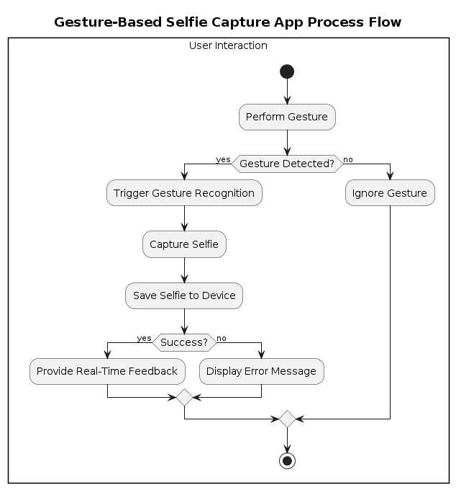
User Interaction: The process begins with the user performing a gesture.
Gesture Detected?: The system then determines if a gesture was detected.
Yes: If a gesture is detected, the system triggers gesture recognition.
No: If no gesture is detected, the system ignores the gesture.
Trigger Gesture Recognition: If a gesture is detected, the system triggers gesture recognition to identify the specific gesture.
Capture Selfie: Once the gesture is recognized, the system captures a selfie.
Save Selfie to Device: The captured selfie is then saved to the user’s device.
Success?: The system checks if the selfie was successfully saved to the device.
Yes: If successful, the system provides real-time feedback to the user. This feedback could be visual, such as a confirmation message on the screen, or auditory, such as a chime.
No: If unsuccessful, the system displays an error message to the user, letting them know that the selfie was not saved.

Slide 3
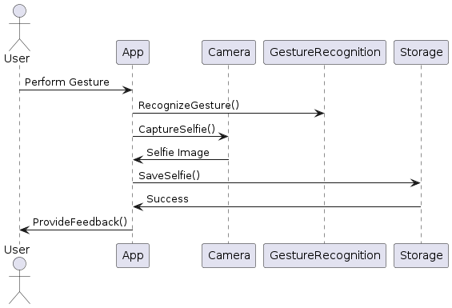
Represents the user interacting with the app
Represents the Gesture-Based Selfie Capture App itself
Represents the device's camera used for capturing selfies
Represents the module responsible for recognizing gestures
Represents the storage component for saving selfies
Sequence of Actions:
User performs a gesture.
The app receives the gesture and triggers the Gesture Recognition module to recognize the gesture.
The app instructs the camera to capture a selfie.
The camera captures the selfie and sends the image back to the app.
The app saves the selfie image in the storage component.
The app confirms successful selfie capture and provides feedback to the user.

Slide 4
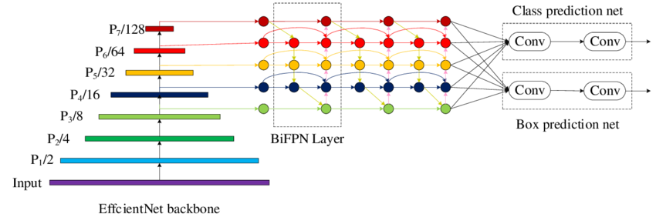
State of the Art for Gesture-Based Selfie Capture App
Gesture Recognition Technology:
Leveraging advanced gesture recognition algorithms, such as Convolutional Neural Networks (CNNs) and deep learning models like EfficientDet-D0, to accurately detect and classify predefined gestures.
Implementing real-time gesture analysis using TensorFlow Lite or similar frameworks to ensure fast and efficient processing on mobile devices.
Mobile Hardware Integration:
Utilizing the device's camera API to capture high-quality selfies with optimal resolution and clarity.
Implementing efficient image processing algorithms to enhance selfie quality, remove noise, and apply real-time filters if desired.
Performance Optimization:
Optimizing app performance by minimizing resource usage, optimizing code for speed, and implementing caching mechanisms for faster response times. Used Quantization for this purpose.(Tflite)

Slide 5
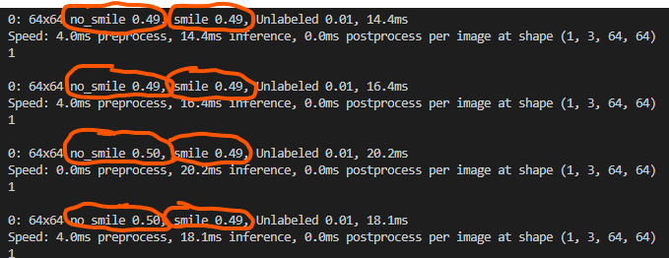
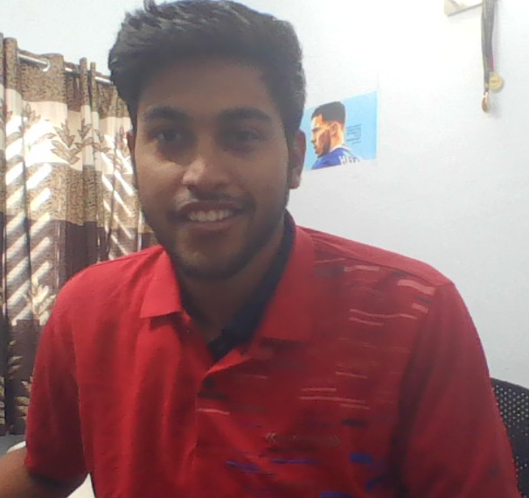
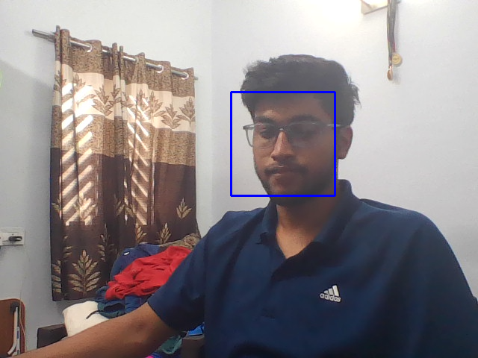
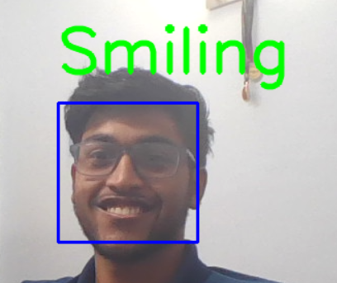
Challenge identification
YOLOv8 Implementation:
Lack of Quantization for Edge Devices: Hindered performance on mobile devices.
Inference Time Optimization: Needed for real-time gesture recognition.
Custom Dataset Performance: Initial training resulted in subpar accuracy.
Haar Cascade Challenges:
Real-Time Implementation Success: Achieved, but accuracy issues with specific gestures.
Deployment in Kotlin: Technical hurdles in integration and performance optimization.
User Interface Transition:
XML Files vs. Jetpack Compose: Transition needed for improved UI responsiveness and scalability.
Challenges in Code Refactoring: Balancing modern UI technologies with stability and performance.

Slide 6
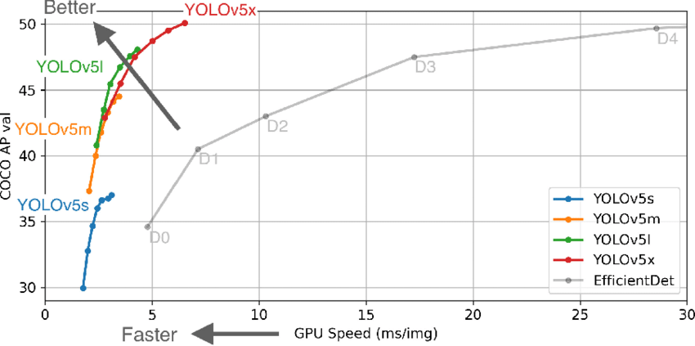
Challenge Solution Proposal
Gesture Recognition Module: EfficientDet-D0 Model
Utilize the EfficientDet-D0 model for accurate and efficient gesture recognition. This model offers improved accuracy and speed, making it ideal for real-time applications on mobile devices.
Leverage transfer learning techniques to fine-tune the EfficientDet-D0 model on a diverse dataset that includes various gestures such as victory, heart, thumbs-up, and smile. This approach ensures robustness and adaptability to different user gestures.
Implement post-processing algorithms to filter and refine gesture predictions, enhancing the overall reliability and precision of gesture recognition in diverse scenarios.
User-Centric Design: Intuitive User Interface
Design an intuitive and user-friendly interface using Jetpack Compose to enhance the overall user experience. Incorporate visual indicators, animations, and intuitive gestures for seamless navigation and interaction within the app.

Slide 7
Risk analysis
Risk | Description | Probability | Impact | Risk Level
Mission and Goals | Misalignment between project goals and user expectations. | low | C | Medium
Program Management | Insufficient resources allocated for project management tasks | Moderate | S | Medium
Decision Drivers | Unclear decision-making criteria leading to delays in project milestones | Moderate | C | Medium
Project Parameters | Scope creep due to frequent changes in project requirements | High | Mi | Low
Product Content | Poor content quality affecting user engagement and retention | Moderate | C | High
Deployment | Deployment issues causing downtime or disruption of service | Moderate | S | Medium
Development Process | Inefficient development processes leading to project delays | High | Mo | Medium

Slide 8

Real-Life Application
The Gesture-Based Selfie Capture App represents a advancement in mobile photography and user interaction, with a wide range of real-life applications that enhance user experience and engagement.
Below is a brief overview of the app's real-life applications:
Personal Photography Enhancement:
The app enables users to capture selfies effortlessly by simply gesturing, eliminating the need to manually press the shutter button. This feature is especially beneficial for users who struggle with traditional selfie-taking methods or require hands-free operation.
Accessibility and Inclusion:
For individuals with mobility impairments or disabilities, the app provides an accessible way to capture selfies without relying on physical gestures or movements. This promotes inclusivity and ensures that everyone can participate in digital self-expression.
Interactive Social Media Experience:
The app enhances the social media experience by allowing users to capture and share unique selfies using gesture-based gestures. This interactive element adds a fun and engaging dimension to social media platforms, encouraging creativity and interaction among users.

Slide 9

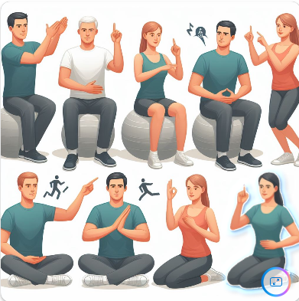
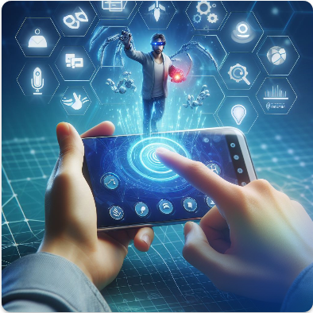
Healthcare and Medical Use Cases:
In healthcare settings, the app can be utilized for patient engagement and monitoring. For example, patients can use specific gestures to capture and share their health-related information, such as vital signs or medication adherence, with healthcare providers.
Educational and Training Tools:
The app can serve as an educational tool for teaching and training purposes. For instance, instructors can demonstrate gestures for sign language or physical therapy exercises, and students can practice and receive feedback using the app.
Gaming and Entertainment:
The app can be integrated into gaming and entertainment applications, allowing users to control gameplay or interact with virtual environments using gestures. This adds a layer of immersion and interactivity to gaming experiences.

Slide 10
Progress Trajectory
Versioning:
The Gesture-Based Selfie Capture App follows a structured versioning system to track its progress and evolution. The versioning scheme includes incremental updates and major releases, ensuring continuous improvement and enhancement of features. Here's an overview of the versioning history:
1.0
Initial release featuring YOLOv8 model for basic gesture recognition
Implemented basic selfie capture functionality with minimal user interaction.
1.1
Improved gesture recognition accuracy and performance optimizations.
1.2
Added support for additional gestures and multi-gesture recognition
2.0
Transitioned to Haar Cascade classifier for improved real-life implementation.
2.1
Optimized Haar Cascade model parameters for better performance
Enhanced real-time feedback mechanisms for user interaction.

Slide 11
3.0
Upgraded to TensorFlow Lite with EfficientDet-D0 model for optimized performance.
Enhanced UI elements for better user experience and intuitive interaction.
3.1
Integrated machine learning models for personalized gesture recognition and user profiling.
Images are saving in Gallery Folder in Internal storage
Advanced gesture recognition capabilities with higher accuracy and speed.
Unit Testing performed and ready for published
Roadmap

Slide 12
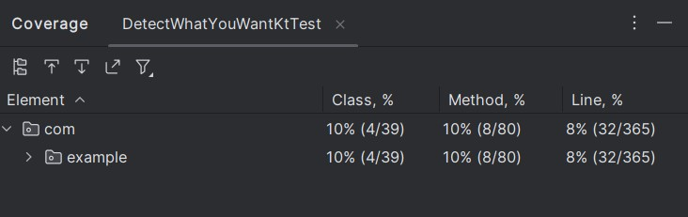
We utilized Kotlin programming language along with Tensor Flow Dependency for gesture detection and image capture functionalities. Code coverage analysis was performed using the inbuilt tool provided by Android Studio, while execution time measurements were obtained through Kotlin timeit library.
Code Coverage Analysis:

Slide 13
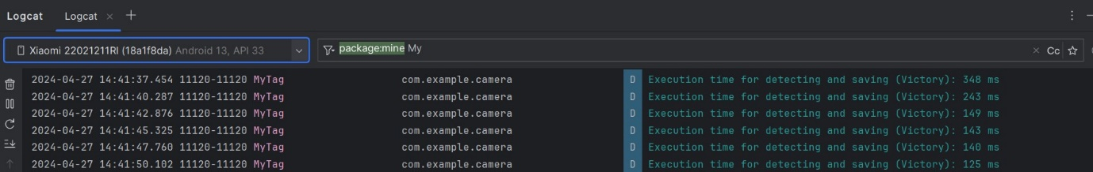
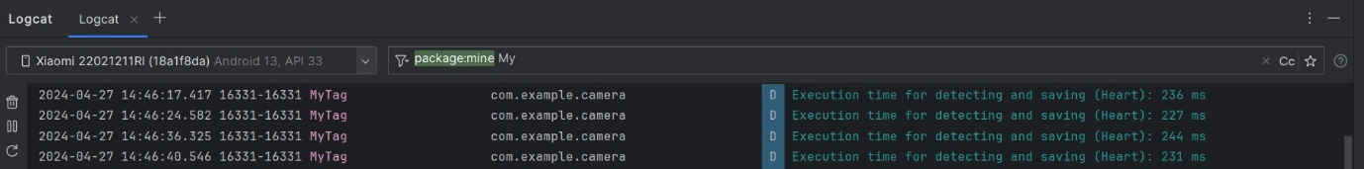
Execution Time Taken by each model:
Model Name | Average Execution Time (in millisecond)
Victory Symbol Detection | 191
Heart Symbol Detection | 235
Thumbs Up Detection | 240

Slide 14
Planned Enhancements for Future Versions:
4.0
Integration with social media platforms for seamless sharing of captured selfies.
Performance monitoring and analytics tools for continuous improvement.
4.1
Introduction of advanced analytics and insights dashboard for users to track gesture usage, trends, and personalization.
Collaboration with hardware manufacturers for optimized integration with cutting-edge devices and sensors.
4.2
Integration of blockchain technology for enhanced data security, privacy, and ownership control.
App publication on Google Play Store for user feedback.

Slide 15
Conclusion
The Gesture-Based Selfie Capture App has evolved through innovation, teamwork, and user-focused design. Starting with YOLOv8 and Haar Cascade models, it now uses TensorFlow Lite with EfficientDet-D0, offering improved accuracy and customization.
Future plans include advanced gesture recognition, AR overlays, and social media sharing. Features like biometric authentication and voice commands will enhance security and interaction. Our commitment to user feedback ensures a cutting-edge and user-friendly experience, shaping the future of mobile photography and interaction.

Slide 16
Team
Advait Gaur (B22CS004)
Developed gesture recognition models using YOLOv8, Haar Cascade, and TensorFlow Lite with EfficientDet-D0
Improved real-life implementation and user interaction through different models.
Documented the functionality, user interfaces, hardware/software interfaces, and communication protocols of the app.
Aniket Singh(B22CS009)
Implemented the app using Kotlin programming language, ensuring efficient and effective development.
Conducted rigorous testing procedures to validate the functionality, performance, and reliability of the app
Documented the app environment, including the development setup, dependencies, and required configurations.

